Slide 1
Main Phases of a Compiler
Compiler Design | Computer Science
Zekarias Teshale

Slide 2
Introduction
A compiler is a software program that translates source code from a high-level programming language (such as C, Java, or Python) into machine code or an executable form understandable by the computer’s processor

Slide 3
Compiler Overview
A compiler works in a sequence of phases, where each phase transforms the program into another form, gradually lowering the level of abstraction until machine code is generated.

Slide 4
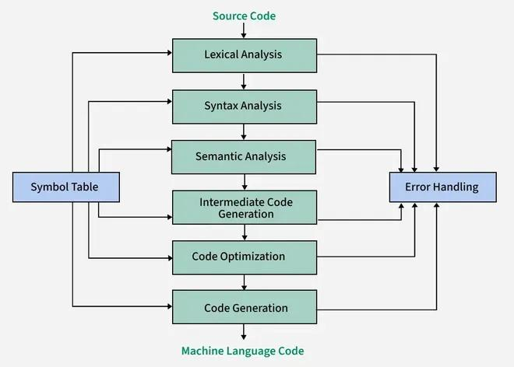
Diagram

Slide 5
1.Lexical Analysis (Scanning)
The first phase where the compiler reads raw source code and groups characters into meaningful tokens (identifiers, keywords, literals, operators).
Purpose:
Remove whitespace and comments
Produce a stream of tokens for syntax analysis.
Example: For int x = 10; → tokens: int, x, =, 10, ;. �

Slide 6
2. Syntax Analysis (Parsing)
Parses the token sequence according to the grammar of the language and builds a parse tree or abstract syntax tree (AST).
Purpose:
Check grammatical correctness
Represent the program’s hierarchical structure
Example:
A = B + C; → parse tree showing = at root with subtrees for operands.

Slide 7
3. Semantic Analysis
Ensures that the parse tree makes logical sense in the language (type checking, correct use of identifiers, scope rules).
Purpose:
Detect type mismatches
Ensure variables are declared before use
Example:
Adding an integer to a string without conversion → semantic error.

Slide 8
4. Intermediate Code Generation
Transforms the syntax tree into an intermediate representation (IR), usually machine-independent, to simplify optimization.
Purpose:
Decouples front-end and back-end processing
IR is easier to optimize and target various architectures.
Example:
Three-address code:
t1 = B * C
t2 = A + t1

Slide 9
Code Optimization
Improves the IR to make the generated code faster or smaller without changing its meaning.
Techniques:
Dead code elimination
Constant folding
Loop optimization
Practical Benefit:
Optimized code runs faster and uses less memory, crucial for performance-critical systems.

Slide 10
6. Code Generation
Final phase that converts optimized IR into machine code or assembly instructions for a specific target processor.
Tasks:
Register allocation
Instruction selection
Address calculation
Example: The IR for a simple arithmetic expression is translated into equivalent assembly code.

Slide 11
Compilation Workflow
Process:
Source code in C → Lexical Analyzer → Tokens
Tokens → Parser → AST
AST → Semantic phase → annotated tree
Annotated tree → IR generation
Optimize IR → reduces execution cost
Code Generation → produces machine code ready to execute

Slide 12
Realife applications
Software development (C, C++, Java, Python programs)
Mobile application development (Android, iOS)
Web browsers and JavaScript engines
Operating systems and device drivers
Game development and game engines
Embedded systems and IoT devices

Slide 13
Conclusion
A compiler has distinct phases, each transforming the program to a lower level.
From lexical analysis to code generation and optimization, each phase adds structure, correctness, and efficiency.
Understanding these phases is essential for diagnosing compilation errors, improving performance, and building new languages.

Slide 14
References
Phases of Compiler — GeeksforGeeks, detailed explanation of compiler phases.
Compiler Design Unit 1 & 2 — Academic PDF with compiler phase descriptions.
Karpagam Academy of Higher Education
Phases of a Compiler — Comprehensive overview from Anna University notes.
CSEIT Exam Preparation

